Slide 1
mimicking abstract classes
Chris Zheng

Slide 2
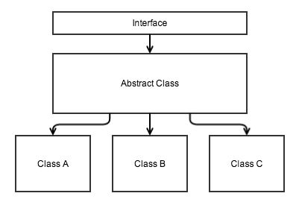
Inheritance in Java

Slide 3
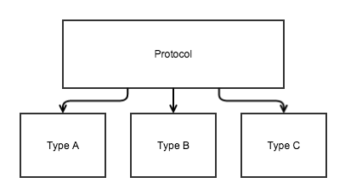
Inheritance in Clojure

Slide 4
Why mimic Java?
Abstract Classes
Extra level of functionality system without worrying about specific implementations
Functionality Reuse
Less Code
Systems as `Objects` (Components)
Flexibility
Type Safety

Slide 5
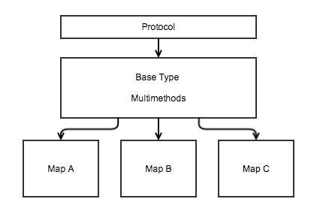
How?

Slide 6
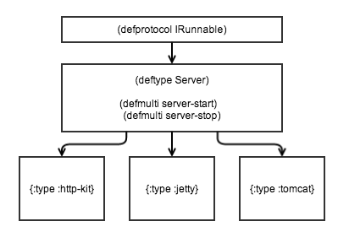
Practical Example

Slide 7
Running Code

Slide 8
Use Case – (Iroh)
Iroh is a reflection library
https://github.com/zcaudate/iroh
Class members are also functions
Static fields are accessors to the class
Static class methods are just functions
Constructors are just functions
Instance fields are accessors to the instance
Instance methods are just functions that take the instance as the first argument.

Slide 9
Use Case – (Iroh)
Each element can be invoked by giving it specific arguments
Different Invocation Methods
java.lang.reflect.Constructor
java.lang.reflect.Field (static and instance)
java.lang.reflect.Method (static and instance)
Overloading

Slide 10
Use Case – (Iroh)
Abstract Container
iroh.types.element/element
Abstract Multimethods
Invoke-element
to-element
element-params
format-element
Concrete Implementations
iroh.element.constructor
iroh.element.field
iroh.element.method
iroh.element.multi

Slide 11
Summary

Slide 12
Pros and Cons
Only one layer of abstraction
Uses only maps
One common `type` to think about:
Server
Authority (doorman)
Class Element (iroh)
Other cases where an abstraction layer is useful
Only need one `print-method`

Slide 13
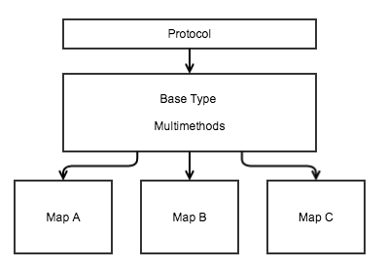
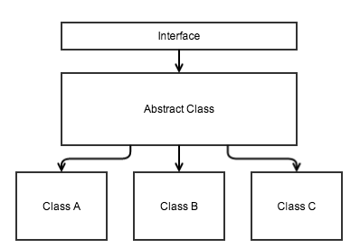
Side by Side

Slide 14
Questions?

